Slide 1
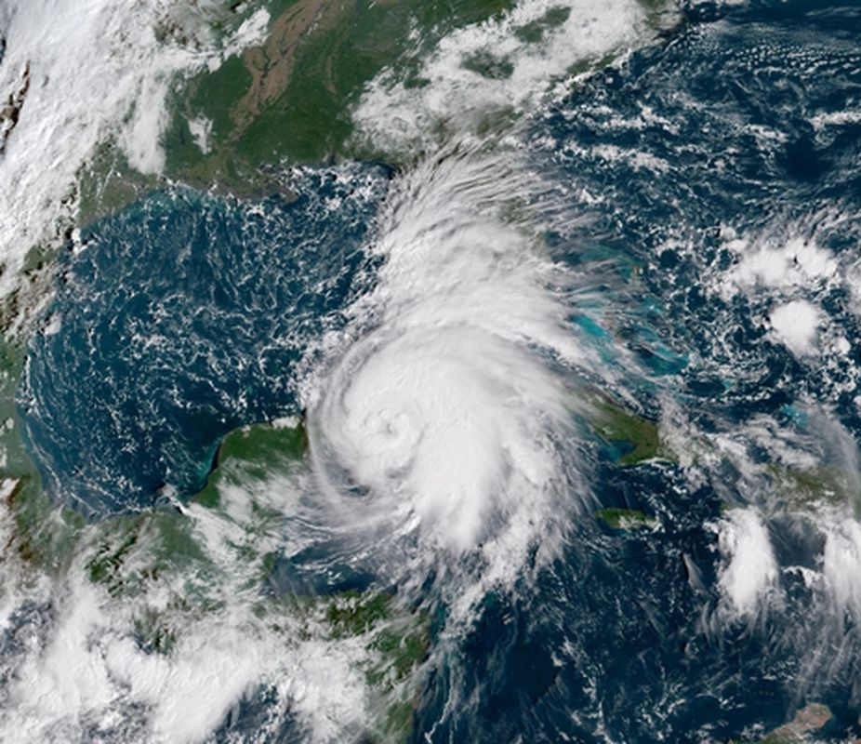
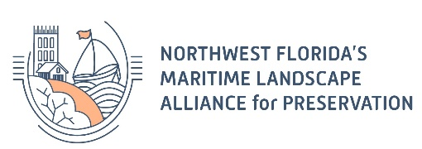
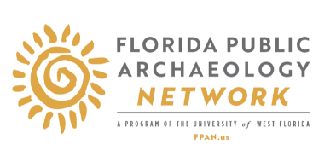
CONNECTING RIVERS, SEA & LAND FLORIDA PANHANDLE MARITIME NATIONAL HERITAGE AREA
Mike Thomin, M.A.

Slide 2
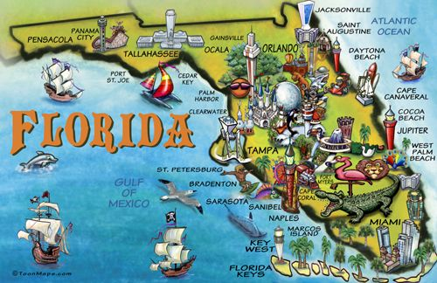

Slide 3
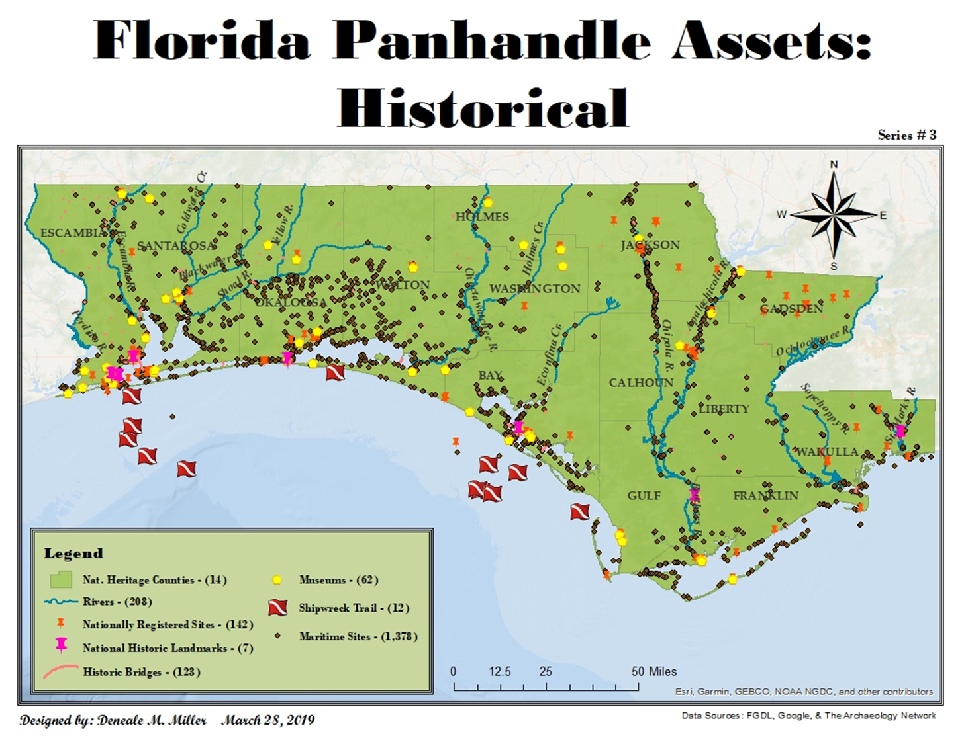

Slide 4
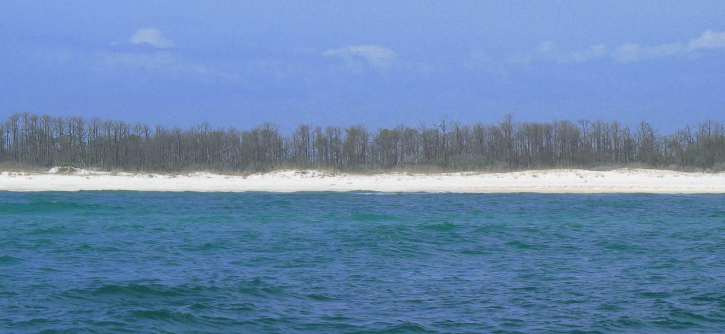
"THE MARITIME LANDSCAPE OF THE FLORIDA PANHANDLE—ITS RIVERS, COASTS, BAYS, AND SOUNDS—HELPED DEVELOP THE UNITED STATES’ NATIONAL DEFENSE, INDUSTRY, ECONOMY, TOURISM, AND INNOVATION INTO WHAT IT IS TODAY."
But, not many know about it!
6

Slide 5
HOW TO MAKE OUR AREA KNOWN NATIONALLY? HOW TO PROMOTE HERITAGE PRESERVATION? HOW TO GET DIFFERENT STAKEHOLDERS INVOLVED? HOW TO ATTRACT MORE DIVERSE TOURISTS? HOW TO BENEFIT FROM OUR CULTURAL AND NATURAL RESOURCES IN A SUSTAINABLE WAY?
HOW CAN WE CHANGE IT?

Slide 6
NATIONAL HERITAGE AREA
Designated by Congress as places where natural, cultural, and historic resources combine to form a cohesive, nationally important landscape.
NHAs are lived-in landscapes. NHAs collaborate with communities to make heritage relevant to local interests and needs.
Through public and private partnerships, NHAs support historic preservation, natural resource conservation, recreation, heritage tourism, and educational projects.
The National Park Service (NPS) provides technical, planning and limited financial assistance to National Heritage Areas.
A NHA is NOT a unit of the National Park Service, nor is any land owned or managed by the NPS. National Park Service involvement is always ADVISORY in nature. NHA’s have no authority to zone, nor can they buy lands with federal funding.

Slide 7
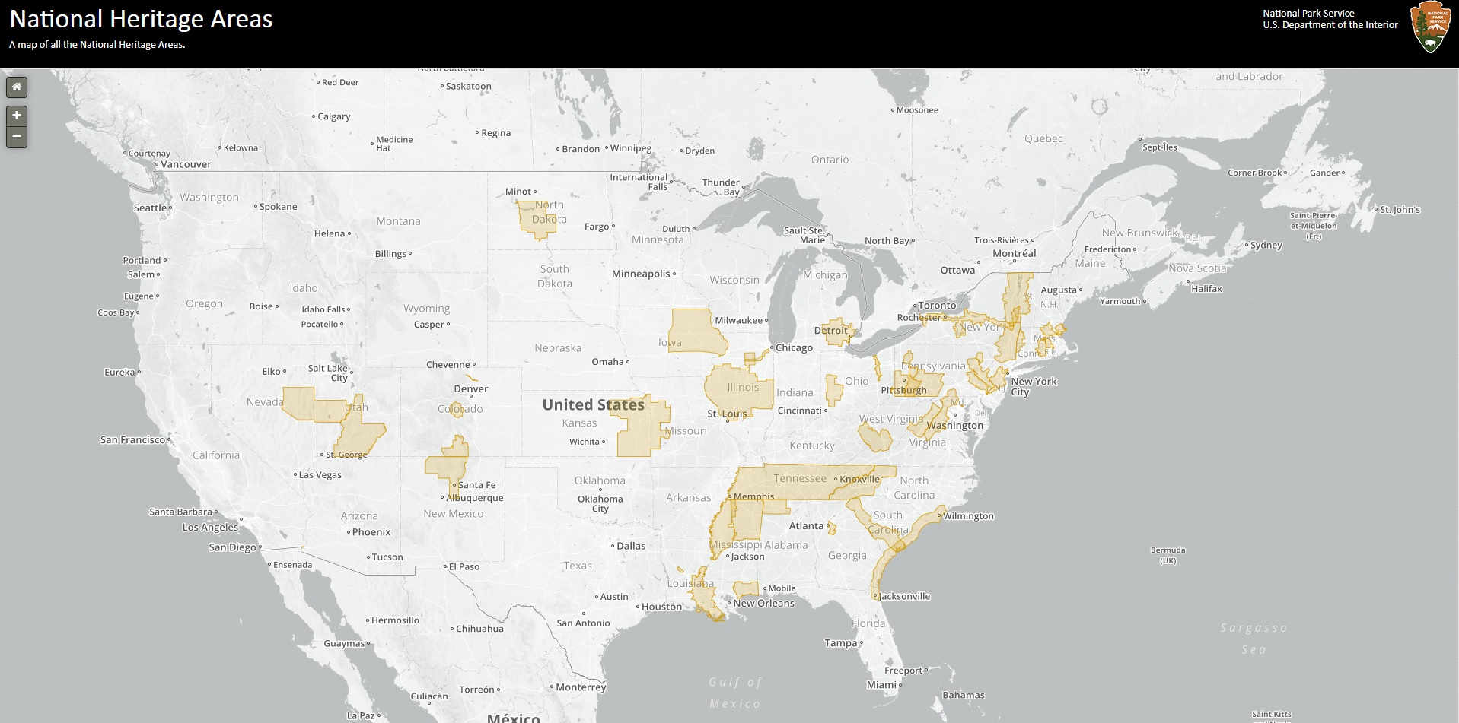
The NHA program includes 55 heritage areas, and is administered by NPS coordinators in Washington DC and six regional offices (Atlanta).

Slide 8
BENEFITS FOR FLORIDA PANHANDLE AREA
Brands the area with a national title
Promotes cultural tourism
Encourages historic preservation (NPS grants, etc.)
Fosters a sense of pride and identity in communities
Sparks pride as the first exclusive NHA in FL (St. Augustine has a bill for “Nation’s Oldest Port NHA” in committee)
Generates economic development, NHAs generate $12.9 billion/yr & $1.2 billion in tax revenue
Creates jobs & supports 148,000 jobs
Receives recurring Federal funding

Slide 9
PROCESS
Feasibility Study:
Assessment of natural, historic, or cultural resources
Assessment of traditions, customs, folklife and beliefs
Evaluating resources conservation opportunities
Develop theme & story
Define the boundaries
Get stakeholders involved
Conduct environmental assessment
Determine economic impact
Consider education & recreational aspects
Create management plan
Submission to NPS => Congress
Management Plan: Mission & Vision |Up to 3 years
Coordinating the Area

Slide 10
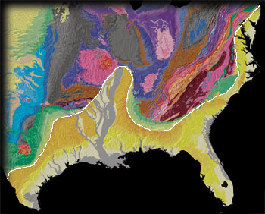
RECENT GEOLOGIC EVENTS HAVE SHAPED THE LANDSCAPE
During the last ice age (~18,000 yrs ago), glaciers pushed ice south;
Creating the North American
Coastal Plain;
Dominated by the Longleaf Pine;
This ecosystem has adapted to fire
due to the frequency of pop-up storms.

Slide 11
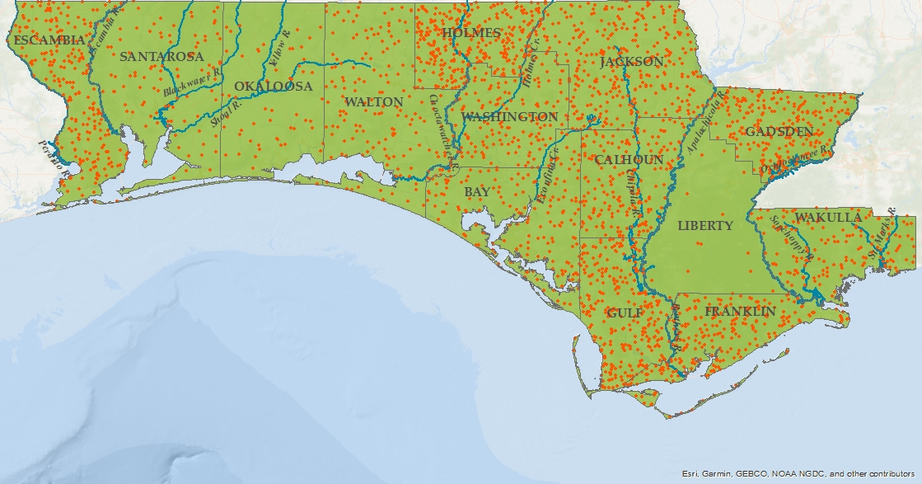
WATERSHEDS DO NOT RECOGNIZE STATE, COUNTY OR CITY BOUNDARIES
These watersheds support a diversity of plants and animals like no other
The population density of imperiled fauna species across the Florida Panhandle
27 species of frogs;
42 species of snakes;
18 species of turtles,
28 species of salamanders;
Over 300 species of birds
Over 2,500 species of plants

Slide 12
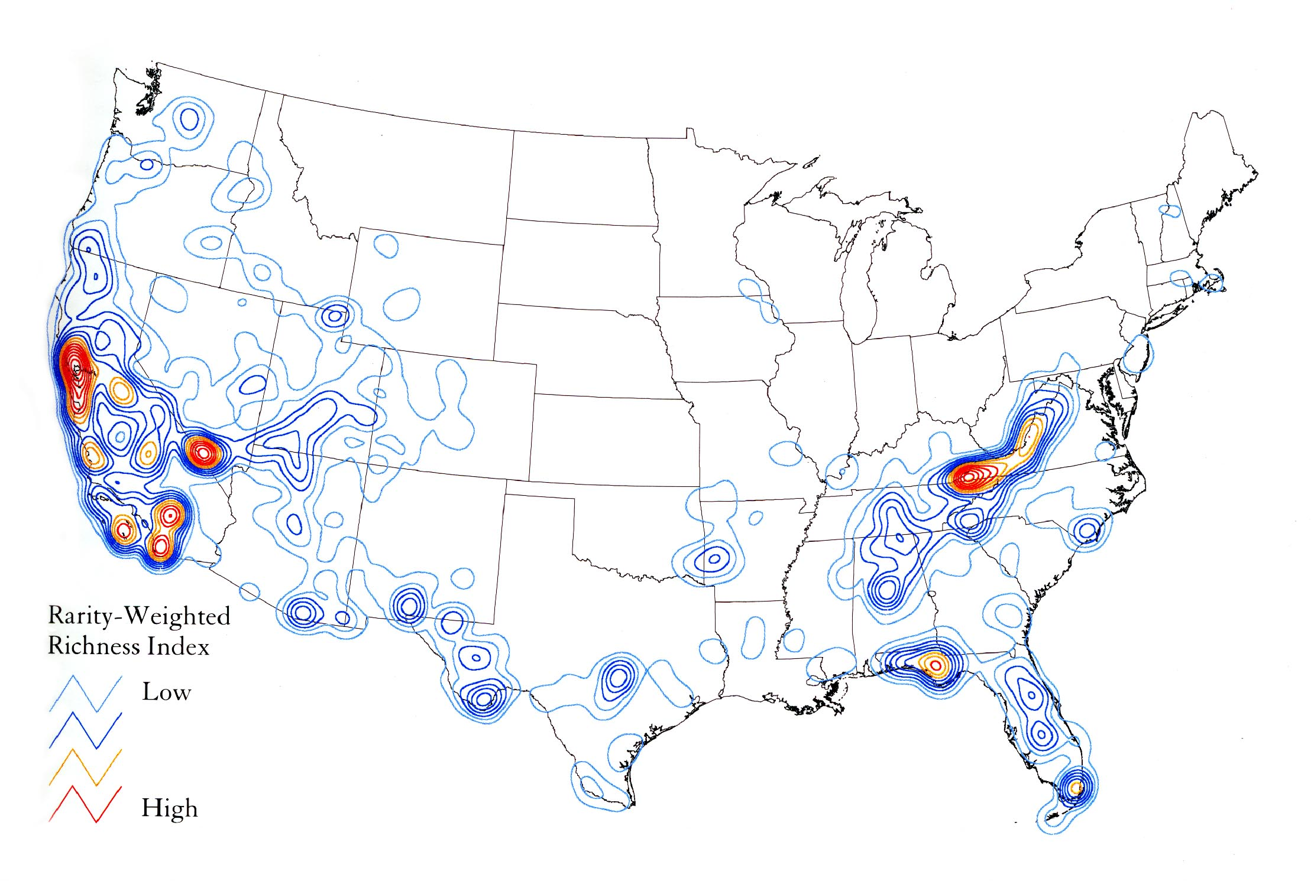
THE PANHANDLE OF FLORIDA IS RECOGNIZED AS ONE OF THE FEW BIOLOGICAL HOTSPOTS IN THE NATION

Slide 13
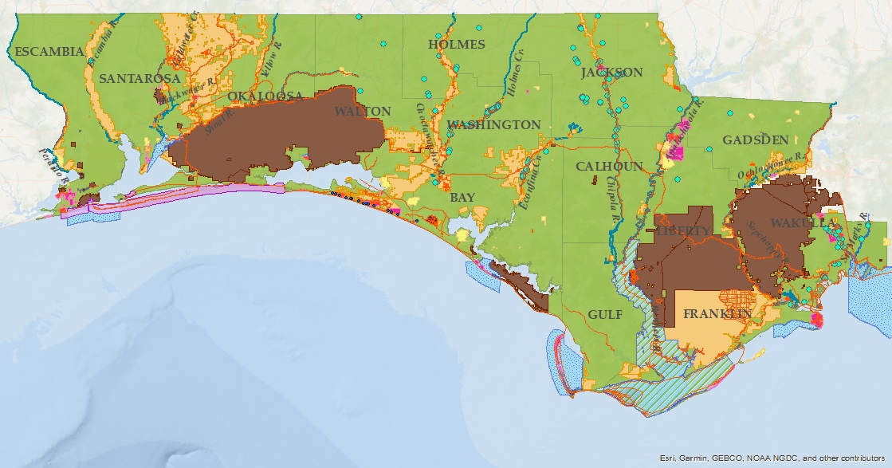
ENVIRONMENTAL ASSETS
Nature’s Irreplaceable Melting Pot
1 National Park
31 State Parks
16 Rivers
244 Springs
198 Management Areas
8 Aquatic Preserves
4 Research Reserves
1 UNESCO Biosphere

Slide 14
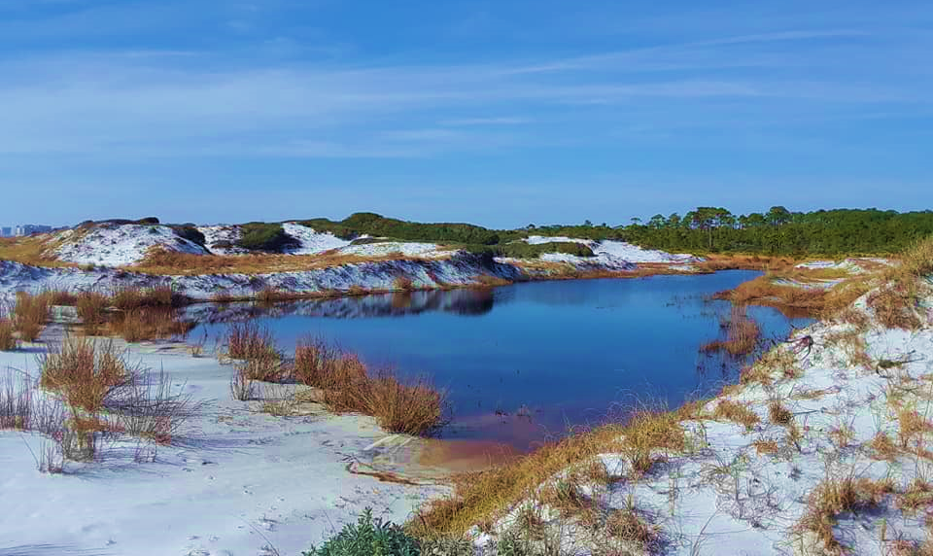
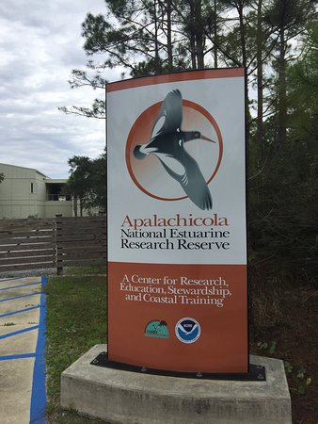
UNIQUE NATURAL RESOURCES
© The Florida Longleaf Pine Ecosystem Geodatabase

Slide 15
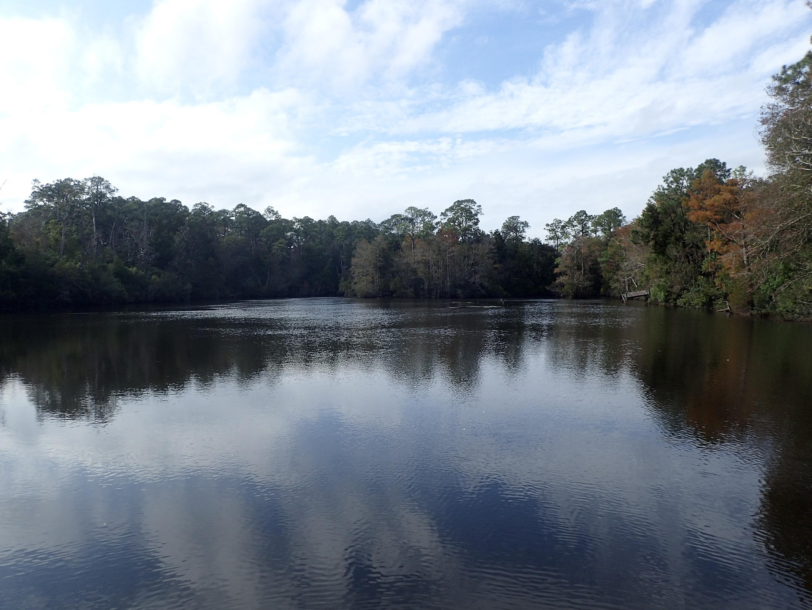
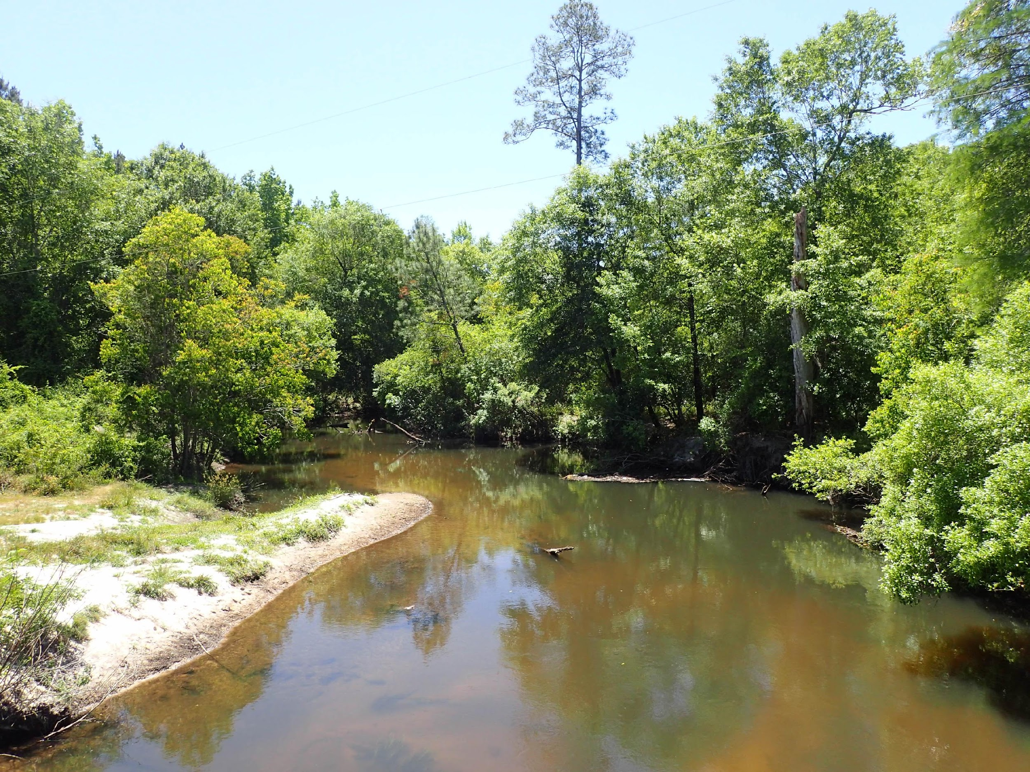
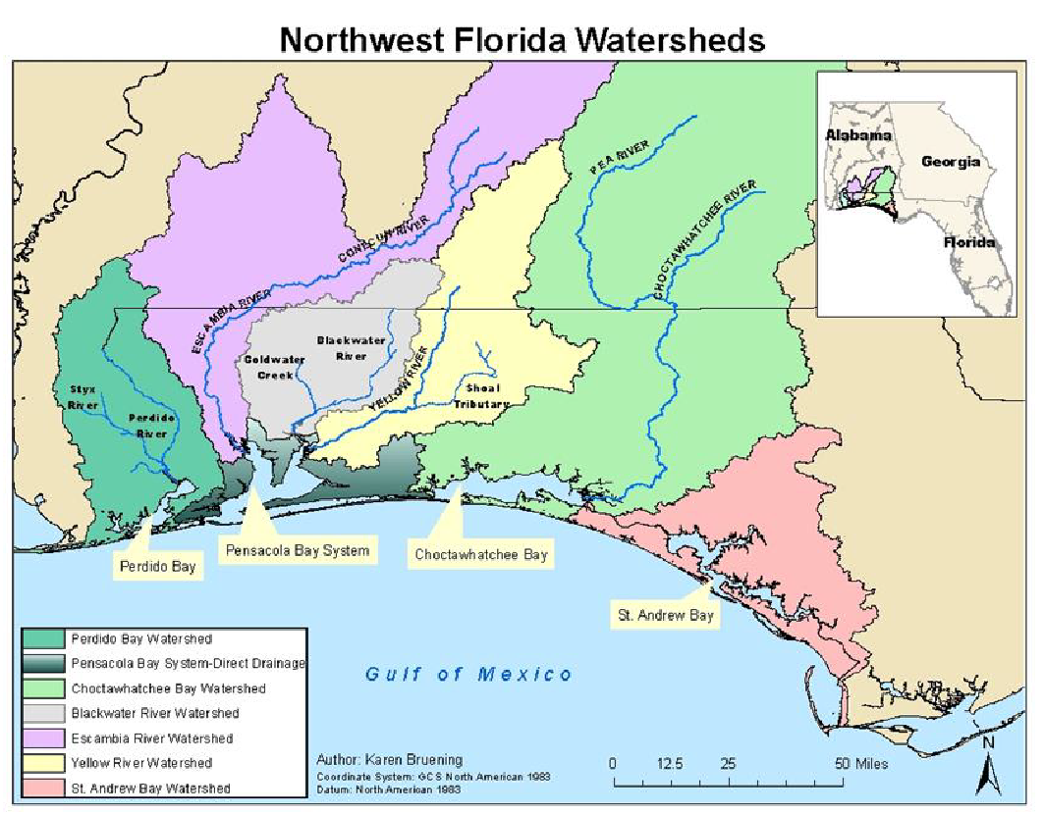
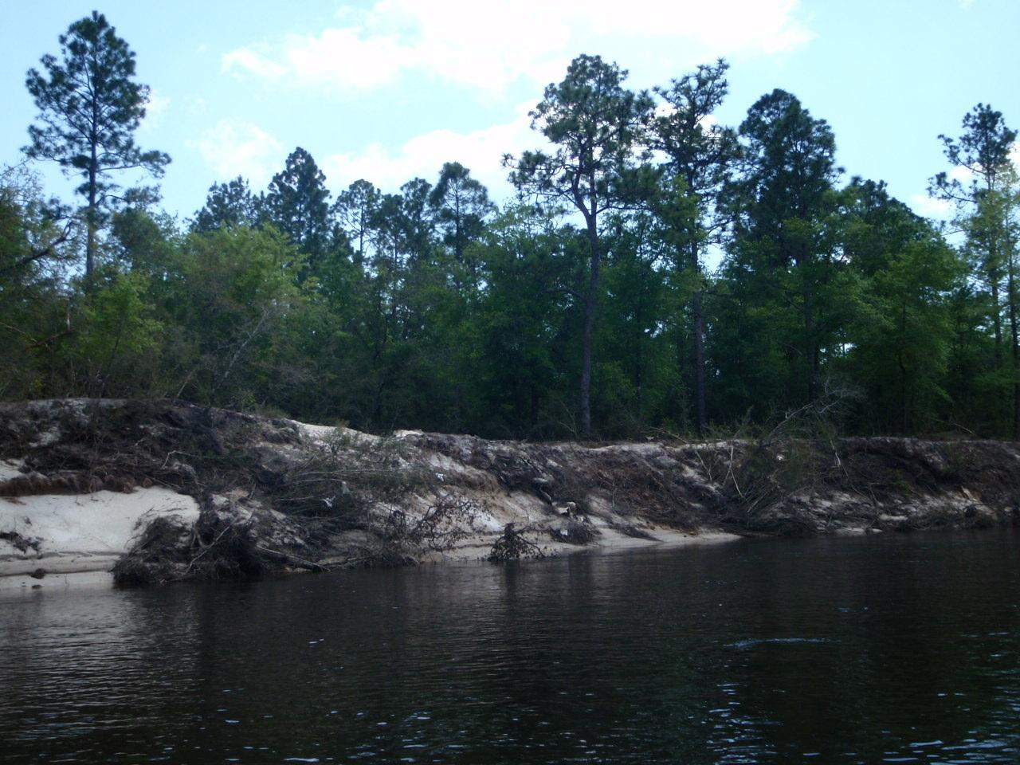
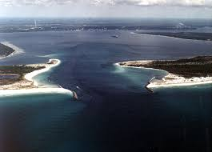
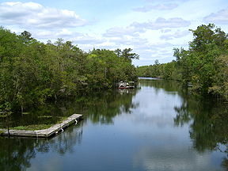
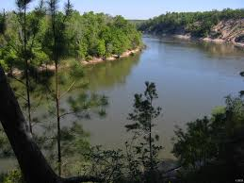
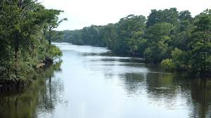
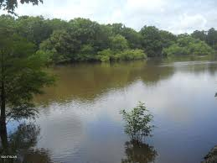
THIS LANDSCAPE: SHAPED BY WATER
Rivers, Bays and Estuaries
Perdido River
Blackwater River
St Andrew Bay | Econfina Creek
Yellow & Shoal River
St Marks River
Apalachicola River
Ochlockonee River
Choctawhatchee River

Slide 16
IMPORTANT STORY TO TELL

Slide 17
NHA designation adds another layer of protection to our environmental resources through harmonized action, communities involvement and education.

Slide 18
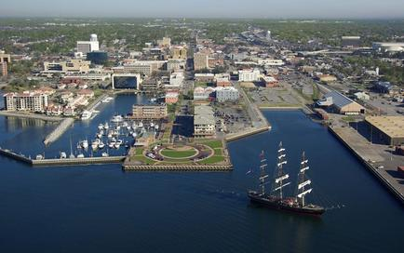
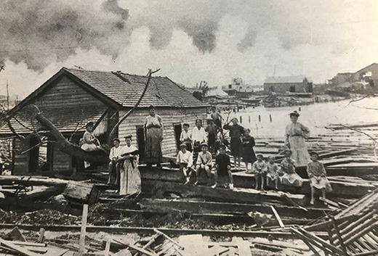
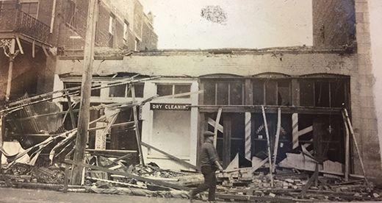
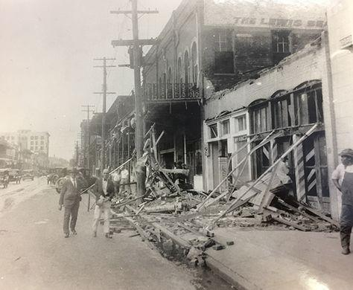
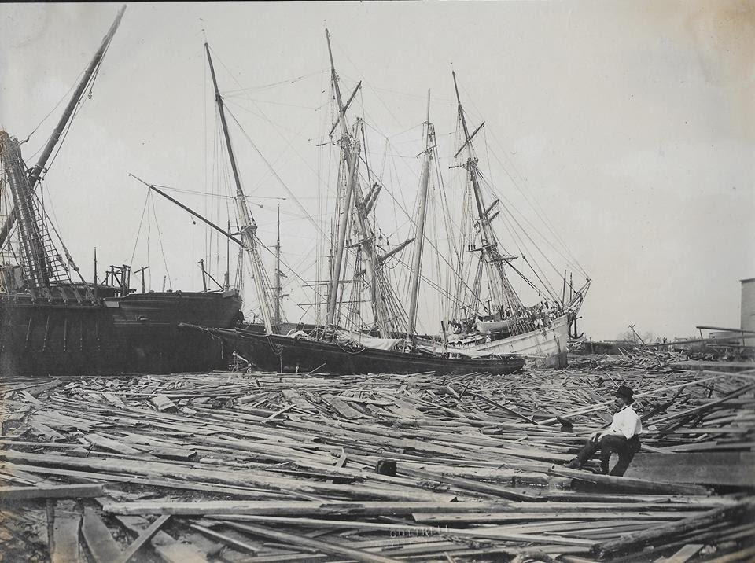
Historic pictures: © UWF Historic trust Archive

Slide 19
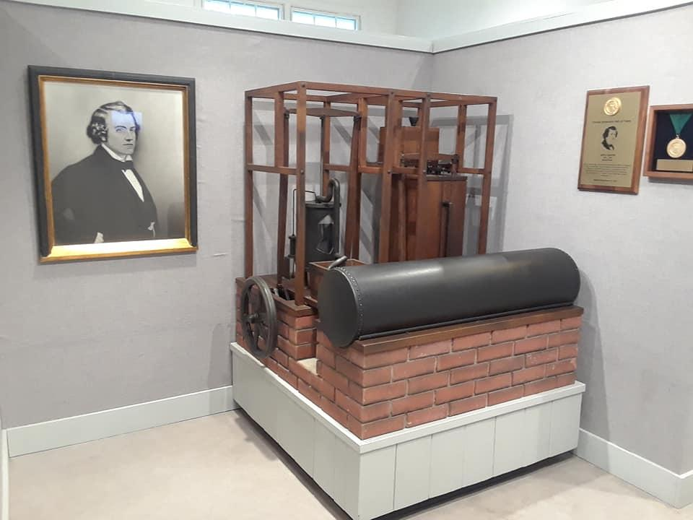
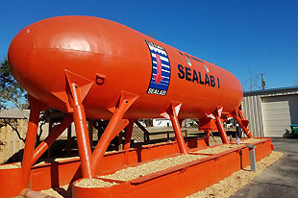
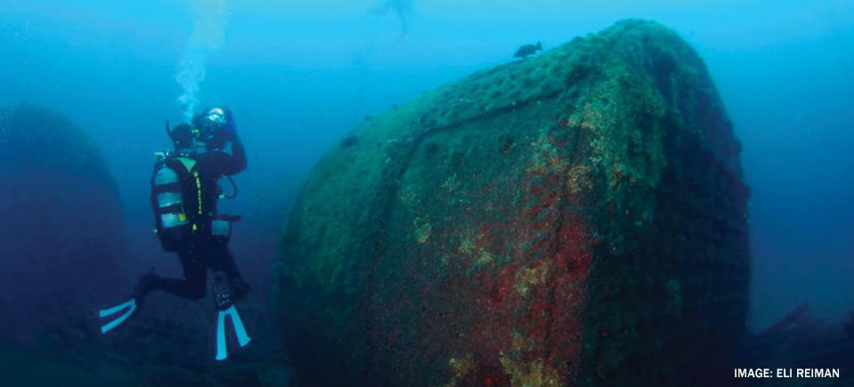
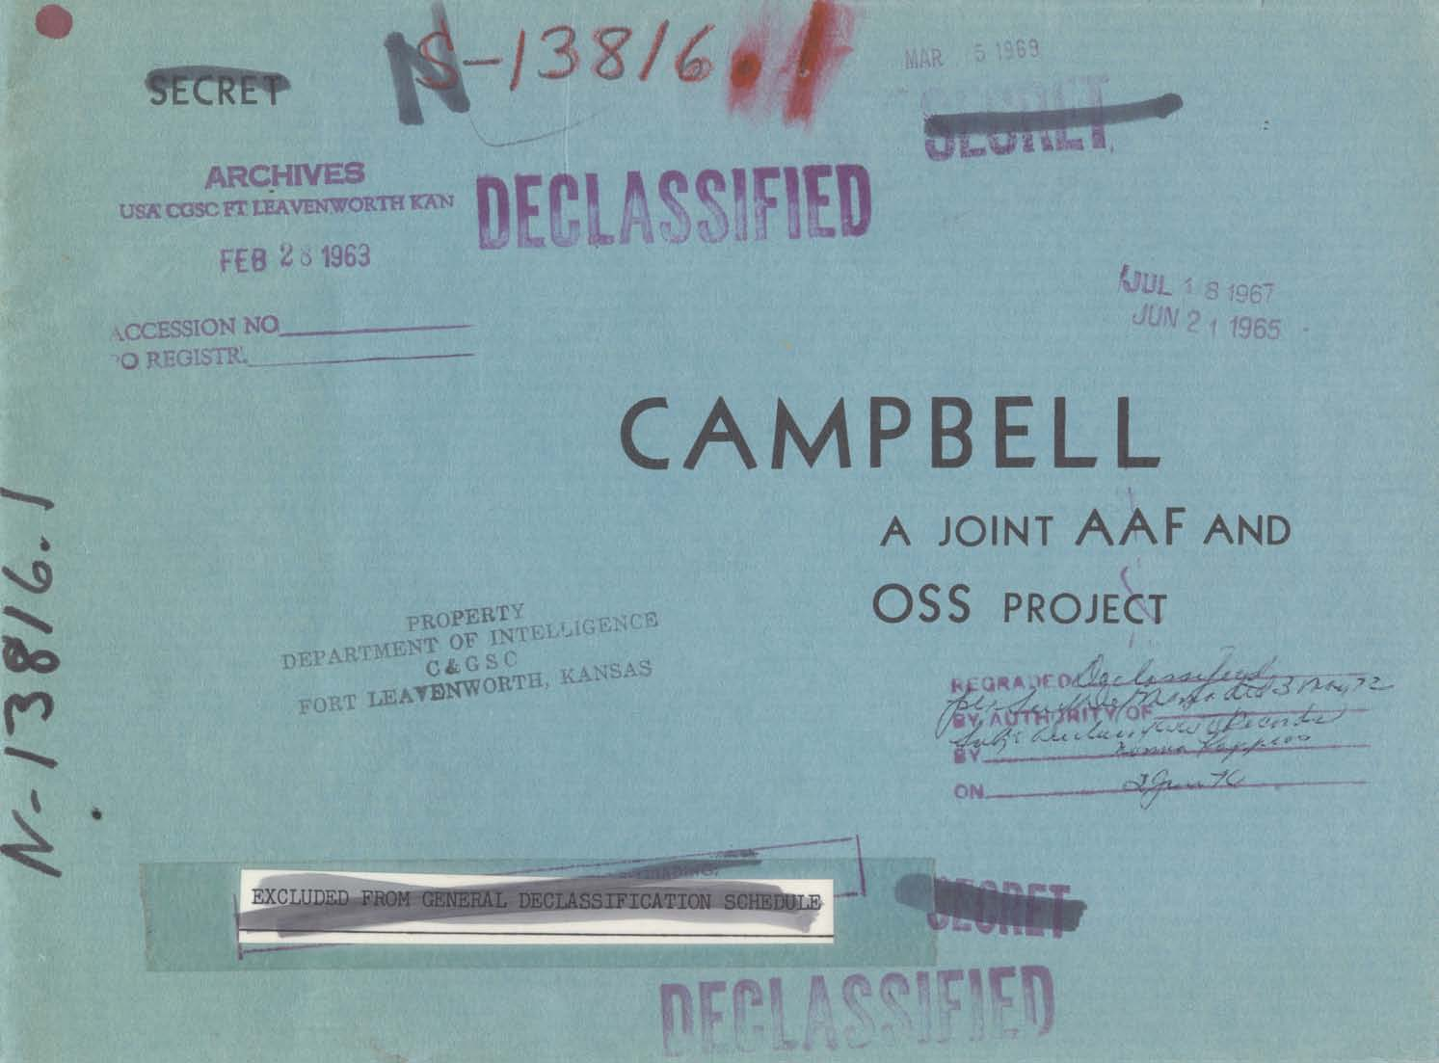
INNOVATION (HISTORIC)

Slide 20
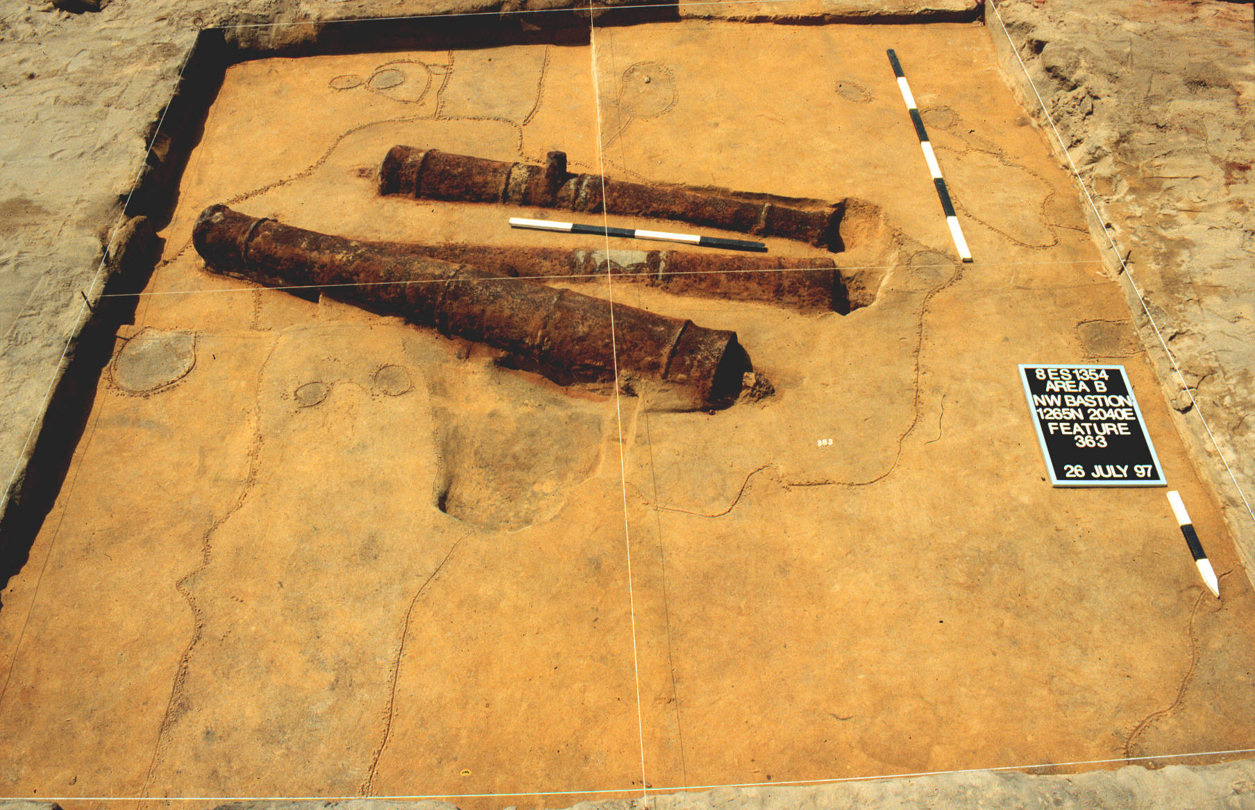
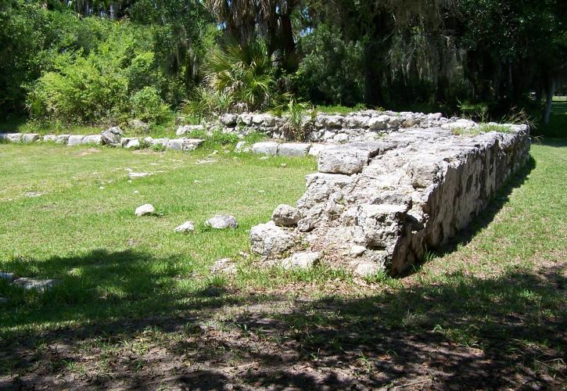
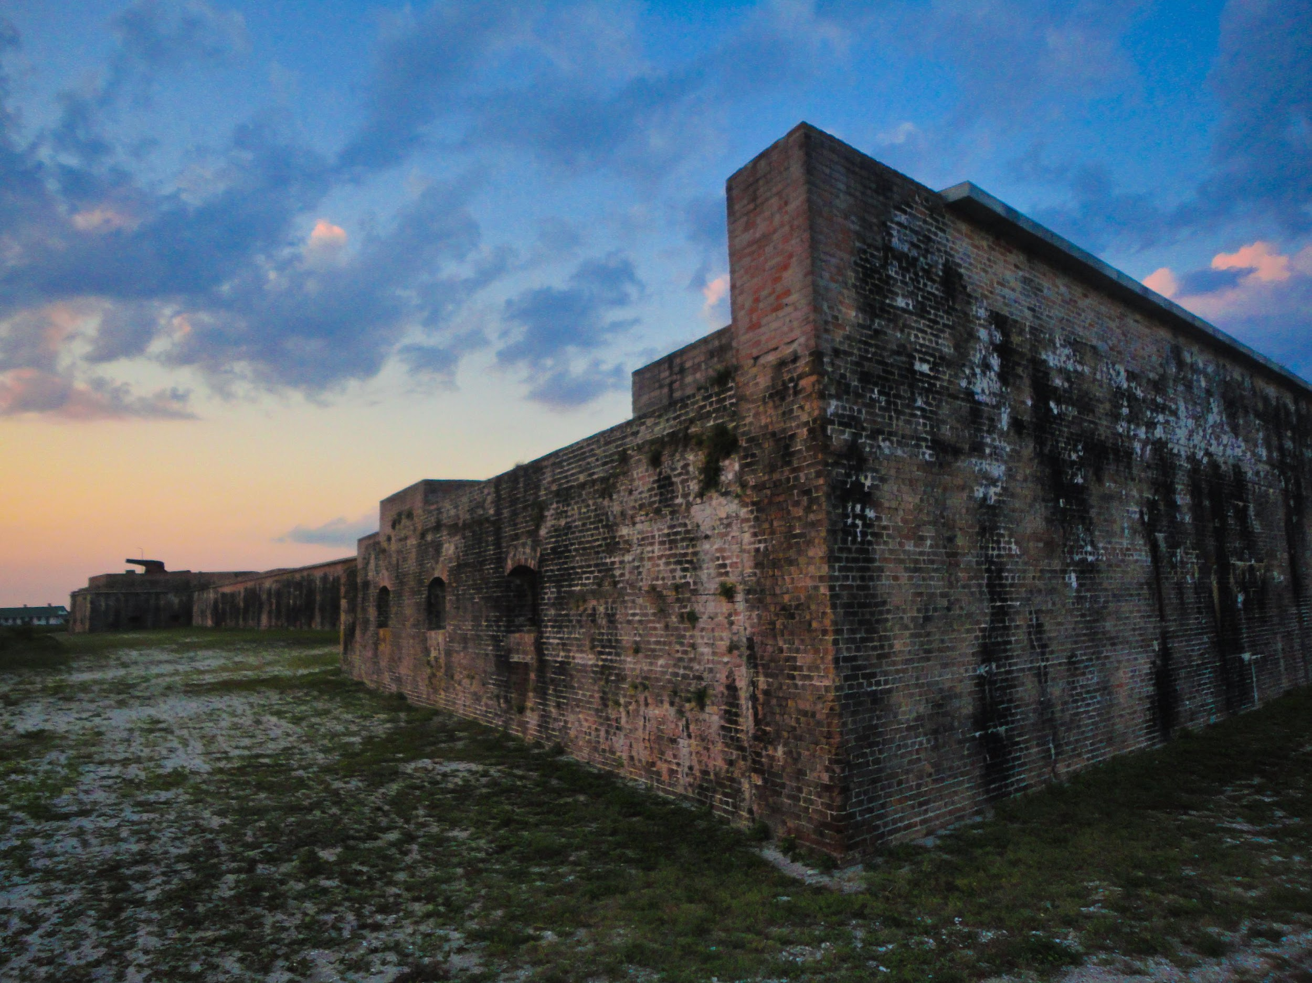
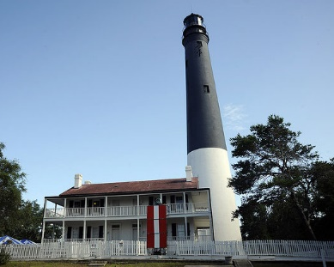
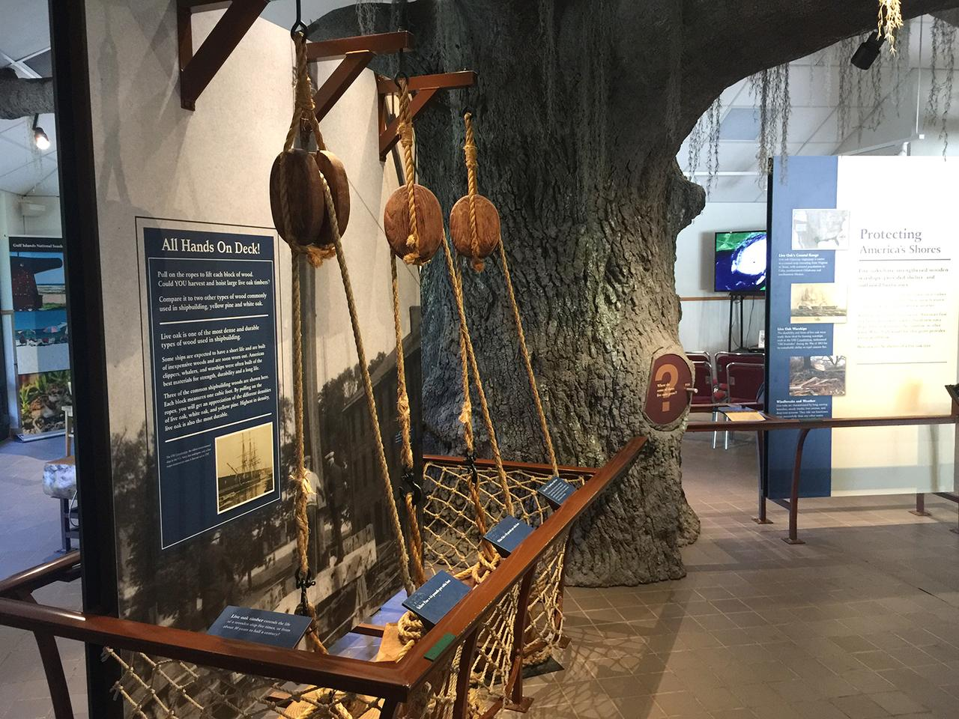
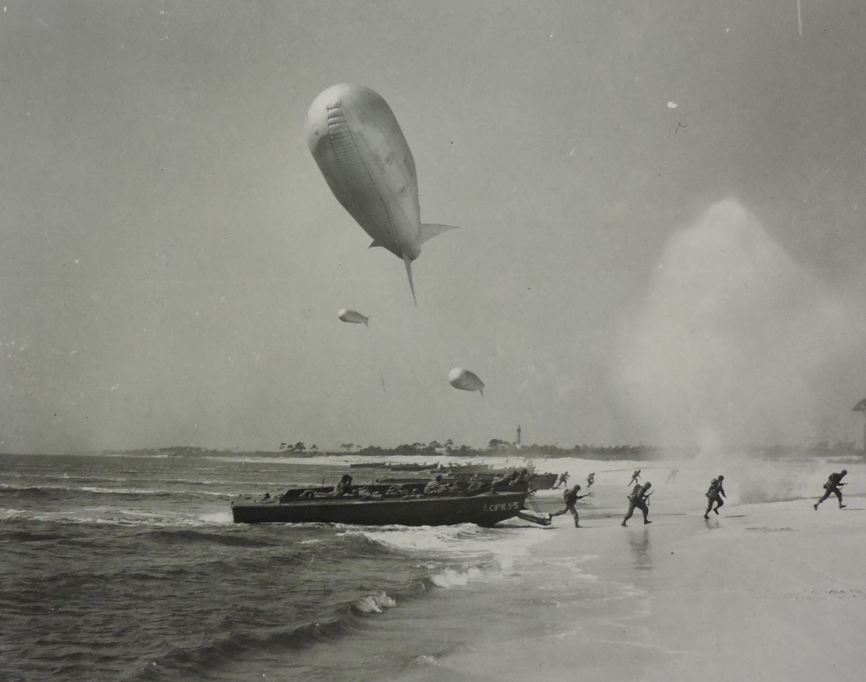
MILITARY AND NATIONAL DEFENSE (HISTORIC)

Slide 21
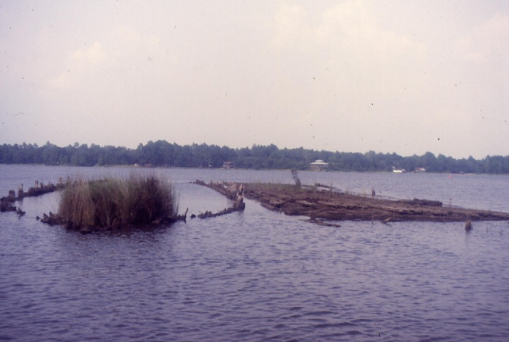
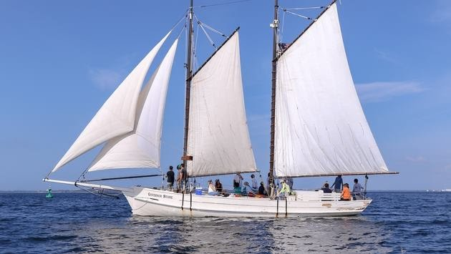
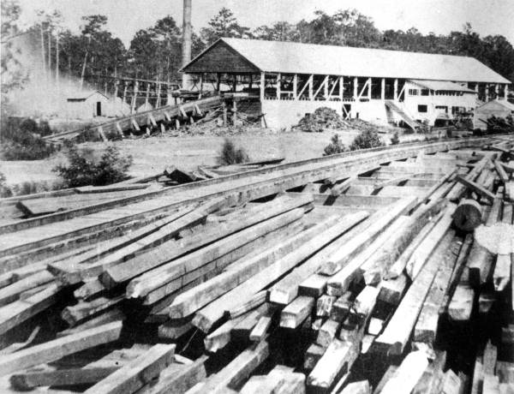
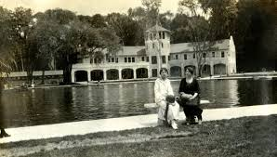
INDUSTRY

Slide 22
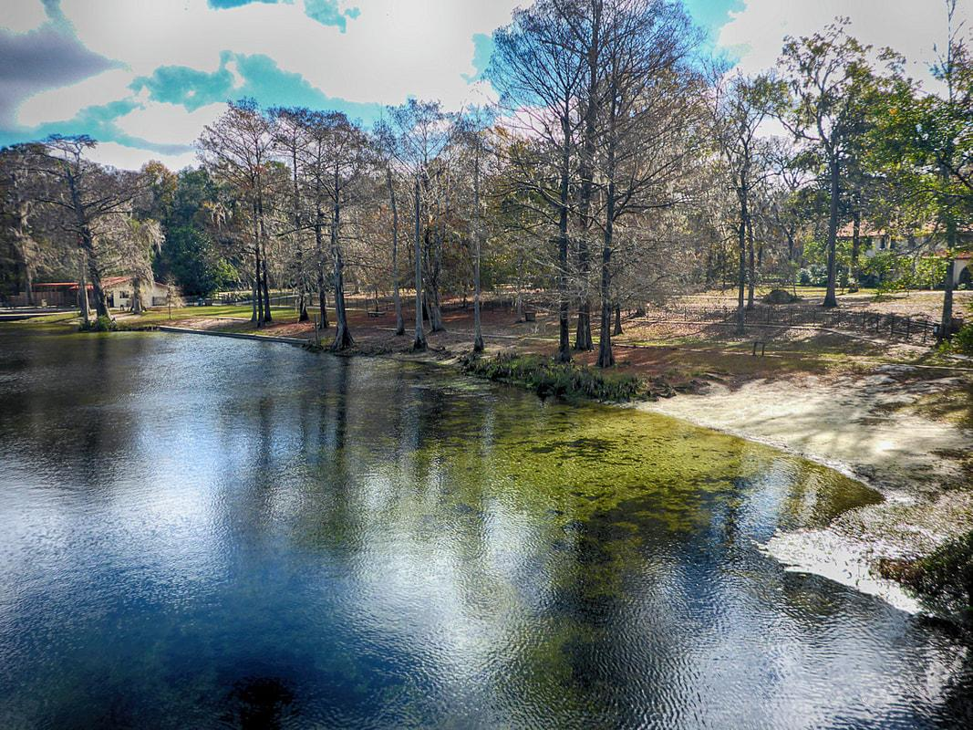
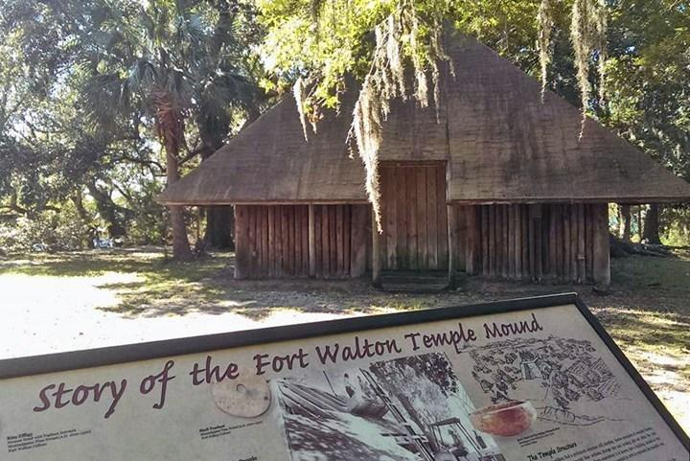
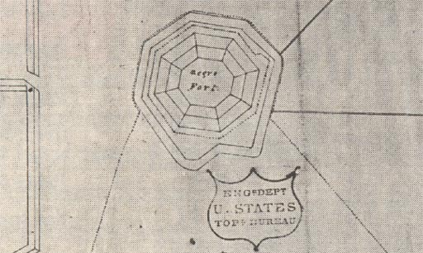
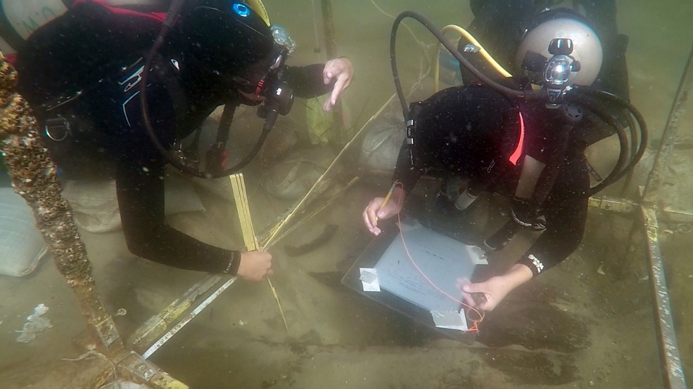
HUMAN RESILIENCE (PREHISTORIC/HISTORIC)

Slide 23
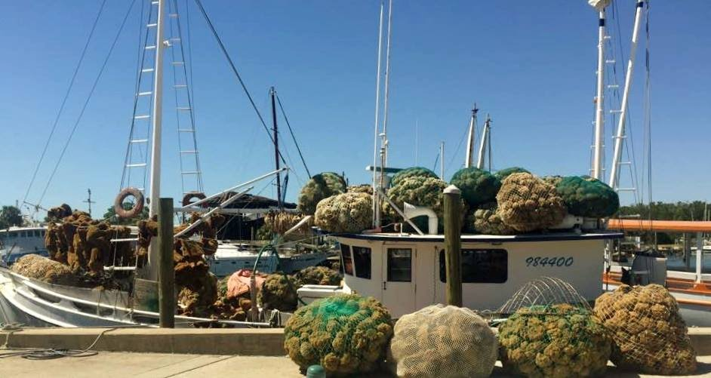
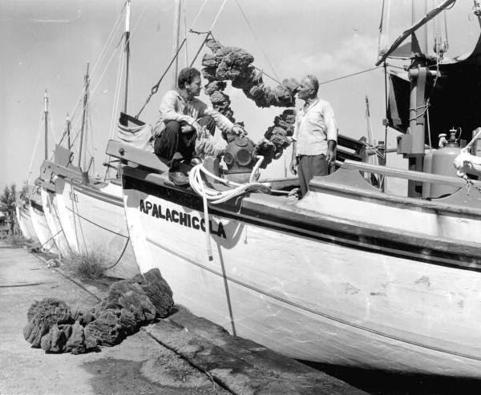
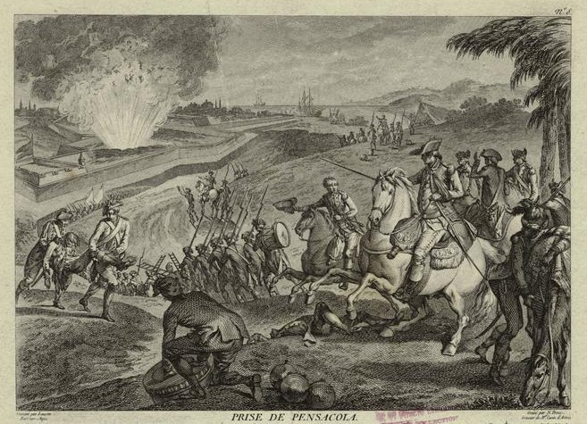
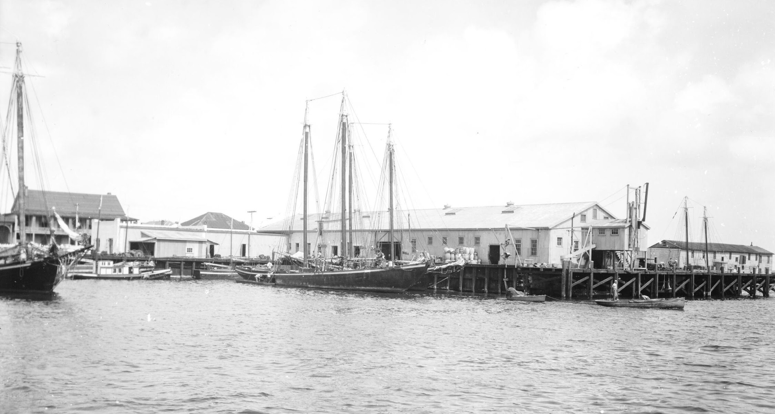
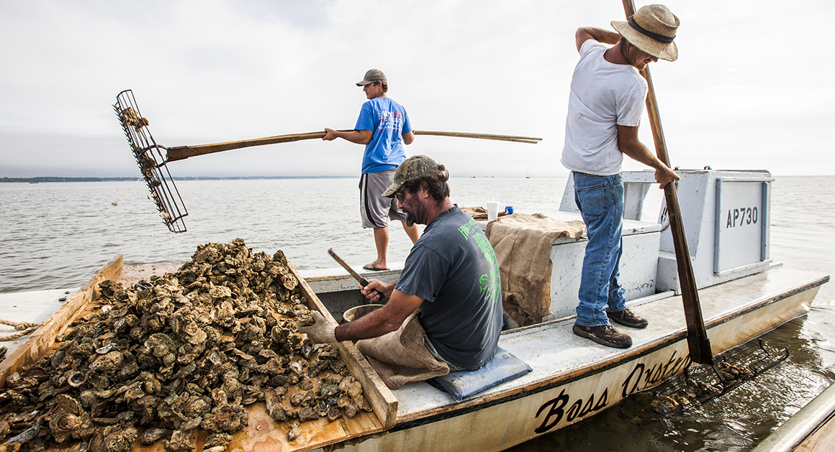
MARITIME HERITAGE CONNECTS OUR PAST TO OUR PRESENT

Slide 24
POTENTIAL BOUNDARY

Slide 25
NOT POSSIBLE WITHOUT AN INTERDISCIPLINARY APPROACH AND COLLABORATIVE STRATEGY
“A PROJECT BY THE PEOPLE AND FOR THE PEOPLE.”
(FORMER ANHA DIRECTOR)

Slide 26
To date we have gathered 127 letters of support from businesses, non-profits, alliances, and local, state, federal entities. The logos below are just a few of them!

Slide 27
WWW.NORTHWESTFLORIDAMLAP.ORG
“Northwest Florida partnerships inspire and educate residents and visitors with an appreciation for how our maritime history influenced the region, the nation, and the world. This rich heritage and natural landscape are a source of pride for our resilient communities, providing a viable recreational, economic, and conservation influence.”
Organized in late 2020 as a way to keep feasibility study moving forward and continue collaboration among partners who have supported NHA effort over the past three years
Registered as a non-profit with the state of Florida in 2021 (10 current board members)
Received 501c3 status in 2021
Main focus right now is on completing feasibility study and submitting it to NPS- also applying for grants to bring speaker series about maritime heritage to Northwest Florida

Slide 28
Thank you!
QUESTIONS?

